Slide 1
The Future of (Biomedical) Ontology:
Overcoming Obstacles to Information Integration
Barry Smith (IFOMIS)
Manchester
17.1.05

Slide 2
The challenge of integrating genetic and clinical data
Two obstacles:
The associative methodology
The granularity gulf

Slide 3
First obstacle: the associative methodology
Ontologies are about word meanings
(‘concepts’, ‘conceptualizations’)

Slide 4
‘Concept’ runs together:
meaning shared in common by synonymous terms
idea shared in common in the minds of those who use these terms
universal, type, feature or property shared in common by entities in the world

Slide 5
There are more word meanings than there are types of entities in reality
unicorn
devil
canceled workshop
prevented pregnancy
imagined mammal
fractured lip ...

Slide 6
A is_a B =def.
‘A’ is more specific in meaning than ‘B’
meningitis is_a disease of the nervous system
unicorn is_a one-horned mammal

Slide 7
Biomedical ontology integration
will never be achieved through integration of meanings or concepts
the problem is precisely that different user communities use different concepts

Slide 8
The linguistic reading of ‘concept’
yields a smudgy view of reality, built out of relations like:
‘synonymous_with’
‘associated_to’

Slide 9
UMLS Semantic Network
anatomical abnormality associated_with daily or recreational activity
educational activity associated with pathologic function
bacterium causes experimental model of disease

Slide 10
The concept approach can’t cope at all with relations like
part_of = def. composes, with one or more other physical units, some larger whole
contains =def. is the receptacle for fluids or other substances

Slide 11
connected_to =def.
Directly attached to another physical unit as tendons are connected to muscles.
How can a meaning or concept be directly attached to another physical unit as tendons are connected to muscles ?

Slide 12
Idea: move from associative relations between meanings to strictly defined relations between the entities themselves

Slide 13


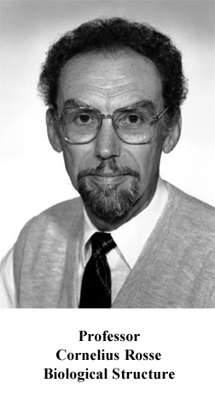
Digital Anatomist
The
first crack
in the wall

Slide 14
Foundational Model of Anatomy
(Department of Biological Structure, University of Washington, Seattle)

Slide 15
Anatomical Space
Anatomical
Structure
is_a
Organ Cavity
Subdivision
Organ
Cavity
Organ
Organ Part
Serous Sac
Cavity
Subdivision
Serous Sac
Cavity
Serous Sac
Organ
Component
Organ
Subdivision
Tissue
Pleural Sac
Pleura(Wall
of Sac)
Pleural
Cavity
part_of
Parietal
Pleura
Visceral
Pleura
Interlobar
recess
Mediastinal
Pleura
Mesothelium
of Pleura

Slide 16
The Gene Ontology
Second crack
in the wall
European Bioinformatics Institute, ...
Open source
Transgranular
Cross-Species
Components, Processes, Functions

Slide 17
But:
No logical structure
Viciously circular definitions
Poor rules for coding, definitions, treatment of relations, classifications
so highly error-prone

Slide 18
New GO / OBO Reform Effort
OBO = Open Biological Ontologies

Slide 19
OBO Library
Gene Ontology
MGED Ontology
Cell Ontology
Disease Ontology
Sequence Ontology
Fungal Ontology
Plant Ontology
Mouse Anatomy Ontology
Mouse Development Ontology
NCI Thesaurus
...

Slide 20
coupled with
Relations Ontology (IFOMIS)
suite of relations for biomedical ontology to be submitted to CEN as basis for standardization of biomedical ontologies
+ alignment of FMA and GALEN

Slide 21
Key idea
To define ontological relations like
part_of, develops_from
not enough to look just at universals / types:
we need also to take account of instances and time
(= link to Electronic Health Record)

Slide 22
Kinds of relations
<universal, universal>: is_a, part_of, ...
<instance, universal>: this explosion instance_of the universal explosion
<instance, instance>: Mary’s heart part_of Mary

Slide 23
part_of
for universals
A part_of B =def.
given any instance a of A
there is some instance b of B
such that
a instance-level part_of b

Slide 24
derives_from
(ovum, sperm → zygote ... )
C
c at t
C₁
c₁ at t₁
time
C'
c' at t
instances

Slide 25
transformation_of
same instance
C
c at t
C₁
c at t₁
time
pre-RNA → mature RNA
child → adult

Slide 26
transformation_of
C₂ transformation_of C₁ =def. any instance of C₂ was at some earlier time an instance of C₁

Slide 27
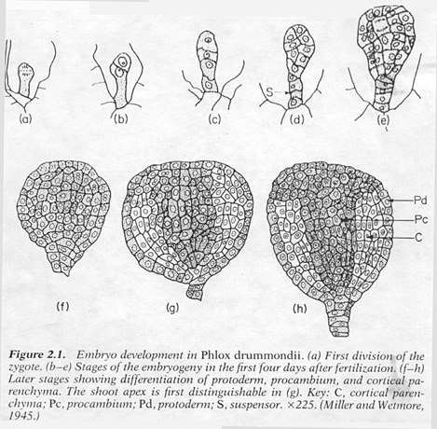
C
c at t
C₁
c at t₁
embryological development

Slide 28
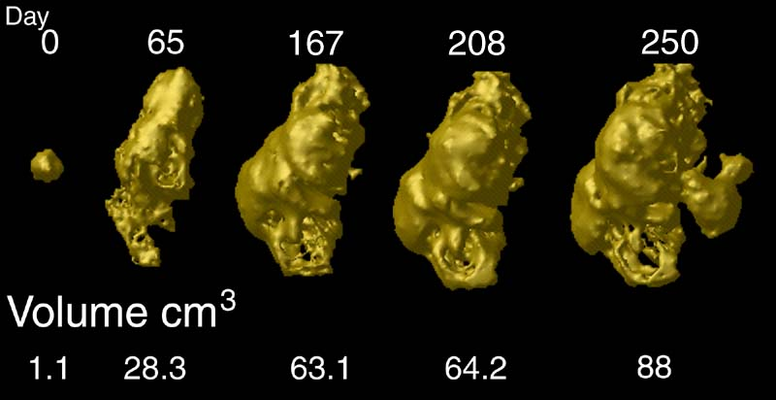
tumor development
C
c at t
C₁
c at t₁
Notes:
http://www.loni.ucla.edu/~thompson/HBM2000/tumor_volumes.jpg

Slide 29
The Granularity Gulf
most existing data-sources are of fixed, single granularity
many (all?) clinical phenomena cross granularities

Slide 30
transformation_of
C
c at t
C₁
c at t₁

Slide 31
Spatial
(Time-Independent)
Relations in Biomedical Ontologies
Maureen Donnelly
Thomas Bittner
Cornelius Rosse

Slide 32
Inverse Relations
PP (my hand, my body)
PP⁻¹(my body, my hand)
Loc-In (my heart, my thoracic cavity)
Loc-In⁻¹(my thoracic cavity, my heart)

Slide 33
Spatial relations between universals
Right Ventricle part_of Heart
Uterus contained_in Pelvic Cavity
.

Slide 34
Three types of inclusion relations among classes
R₁(A, B) =: ∀x (Inst(x, A) → ∃y(Inst(y, B) & Rxy))
(every A is stands in relation R to some B)
R₂(A, B) =: ∀y (Inst(y, B) → ∃x(Inst(x, A) & Rxy))
(for every B there is some A that stands in relation R to it)
R₁₂(A, B) =: R₁(A, B) & R₂(A, B)

Slide 35
Examples
PP₁ (every A is a proper part of some B)
Example: PP₁(Uterus, Pelvis)
PP₂ (every B has some A as a proper part)
Example: PP₂(Cell, Heart)
(but NOT: PP₂(Uterus, Pelvis) and NOT: PP₁(Cell, Heart))
PP₁₂(A, B) =: PP₁(A, B) & PP₂(A, B)
(every A is a proper part of some B and every B has some A as a proper part)
Example: PP₁₂(Left Ventricle, Heart)

Slide 36
Examples
Loc-In₁(A, B) (every A is located in some B)
Example: Loc-In₁(Uterus, Pelvic Cavity)
Loc-In₂(A, B) (every B has some A located in it)
Example: Loc-In₂(Urinary Bladder, Male Pelvic Cavity)
(but NOT: Loc-In₂(Uterus, Pelvic Cavity) and NOT: Loc-In₁(Urinary Bladder, Male Pelvic Cavity))
Loc-In₁₂(A, B)
Example: Loc-In₁₂(Brain, Cranial Cavity)

Slide 37
Properties of relations among individuals vs. properties of relations among classes
Among Individuals | Among Classes
R is... | R₁ must also be...? | R₂ must also be...? | R₁₂ must also be...?
Reflexive | Yes | Yes | Yes
Irreflexive | No | No | No
Symmetric | No | No | Yes
Asymmetric | No | No | No
Antisymmetric | No | No | No
Transitive | Yes | Yes | Yes

Slide 38
Some inferences supported by the theory
 | PP₁(B, C) | PP₂(B, C) | PP₁₂(B, C) | Loc-In₁(B, C) | Loc-In₂(B, C) | Loc-In₁₂(B,C)
PP₁(A, B) | PP₁(A, C) |  | PP₁(A, C) | Loc-In₁(A, C) |  | Loc-In₁(A, C)
PP₂(A, B) |  | PP₂(A, C) | PP₂(A, C) |  | Loc-In₂(A, C) | Loc-In₂(A, C)
PP₁₂(A, B) | PP₁(A, C) | PP₂(A, C) | PP₁₂(A, C) | Loc-In₁(A, C) | Loc-In₂(A, C) | Loc-In₁₂(A, C)
Loc-In₁(A, B) | Loc-In₁(A, C) |  | Loc-In₁(A, C) | Loc-In₁(A, C) |  | Loc-In₁(A, C)
Loc-In₂(A, B) |  | Loc-In₂(A, C) | Loc-In₂(A, C) |  | Loc-In₂(A, C) | Loc-In₂(A, C)
Loc-In₁₂(A, B) | Loc-In₁(A, C) | Loc-In₂(A, C) | Loc-In₁₂(A, C) | Loc-In₁(A, C) | Loc-In₂(A, C) | Loc-In₁₂(A, C)

Slide 39
Some inferences supported by the theory
 | Is_a(C, A) | Is_a(A, C) | Is_a(C, B) | Is_a(B, C)
PP₁(A, B) | PP₁(C, B) |  |  | PP₁(A, C)
PP₂(A, B) |  | PP₂(C, B) | PP₂(A, C)
PP₁₂(A, B) | PP₁(C, B) | PP₂(C, B) | PP₂(A, C) | PP₁(A, C)

Slide 40
Parthood and containment relations in the FMA and GALEN

Slide 41
Class Parthood in the FMA
The FMA uses part_of as a class parthood relation.
has_part is used as the inverse of part_of

Slide 42
Examples of FMA assertions using part_of
1a | Female Pelvis part_of Body | PP₁
1b | Male Pelvis part_of Body | PP₁
2 | Cavity of Female Pelvis part_of Abdominal Cavity | PP₁
3a | Urinary Bladder part_of Female Pelvis | PP₂
3b | Urinary Bladder part_of Male Pelvis | PP₂
4 | Cell part_of Tissue | PP₂
5 | Right Ventricle part_of Heart | PP₁₂
6 | Urinary Bladder part_of Body | PP₁₂
7 | Nervous System part_of Body | PP₁₂

Slide 43
Class-level parthood in GALEN
GALEN uses isDivisionOf as one of its most general class parthood relations = in most (but not all) cases a restricted version of PP₁
GALEN designates hasDivision as the inverse of isDivisionOf
but uses it as a restricted version of PP⁻¹₁ i.e. as the inverse of PP₂, NOT of PP₁.
When PP₁₂(A, B) holds GALEN usually (but not always) asserts both A isDivisionOf B and B hasDivision A

Slide 44
GALEN’s isDivisionOf |  | GALEN’s hasDivision
Female Pelvic Cavity isDivisionOf Pelvic Part of Trunk | PP₁ | none
Prostate Gland isDivisionOf Genito-Urinary System | PP₁ | none
none |  | Pelvic Part of Trunk hasDivision Hair | (PP⁻¹)₁
LeftHeartVentricle isDivisionOf Heart | PP₁₂ | Heart hasDivision LeftHeartVentricle | (PP⁻¹)₁₂
Prostate Gland isDivisionOf Male Genito-Urinary System | PP₁₂ | Male Genito-Urinary System hasDivision Prostate Gland | (PP⁻¹)₁₂
Urinary Bladder isDivisionOf Genito-Urinary System | PP₁₂ | none

Slide 45
GALEN’s isContainedIn
behaves in many (but not all) cases as a restricted version of Loc-In₁
Contains it designates as the inverse of isContainedIn
But, Contains used not as the inverse of isContainedIn but rather (mostly) as a restricted version of the inverse of Loc-In₂, NOT the inverse of Loc-In₁

Slide 46
GALEN’s isContainedIn |  | GALEN’s Contains
Ovarian Artery isContainedIn Pelvic Cavity | Loc-In₁ | Pelvic Cavity Contains Ovarian Artery | (Loc-In⁻¹)₂
Uterus isContainedIn Pelvic Cavity | Loc-In₁ | none
none |  | Venous Blood Contains Haemoglobin | (Loc-In⁻¹)₁
none |  | Male Pelvic Cavity Contains Urinary Bladder | (Loc-In⁻¹)₁
Uterus isContainedIn Female Pelvic Cavity | Loc-In₁₂ | Female Pelvic Cavity Contains Uterus | (Loc-In⁻¹)₁₂
Mediastinum isContainedIn Thoracic Space | Loc-In₁₂ | Thoracic Space Contains Mediastinum | (Loc-In⁻¹)₁₂
Larynx isContainedIn Neck | Loc-In₁₂ | Neck Contains Larynx | (Loc-In⁻¹)₁₂

Slide 47
Also in GALEN...
Speech Contains Verbal Statement
Inappropriate Speech Contains Inappropriate Verbal Statement
Vomitus Contains Carrot

Slide 48
The Future of Ontology
Consistency with the Relation Ontology now criterion for admission to OBO ontology library

Slide 49
Next steps
Marshall Plan-like dissemination effort (GO/OBO, Stanford, FMA, IFOMIS) to entrench not only sound logical principles but also clear rules for coding in ontology development
designed to:
remove duplication of effort
promote quality assurance
guarantee automatic interoperability

